Slide 1
Registers
Computer Organization And Assembly Language
Muhammad Asim

Slide 2
Registers
A register is a temporary storage area built into a CPU. Some registers are used internally and cannot be accessed outside the processor, while others are user-accessible. Most modern CPU architectures include both types of registers.
Internal registers include the instruction register (IR), memory buffer register (MBR), memory data register (MDR), and memory address register (MAR). The instruction register fetches instructions from the program counter (PC) and holds each instruction as it is executed by the processor.
User-accessible registers are larger than internal registers and typically hold data for a longer time. For example, a data register may store individual values referenced being by a currently running program.

Slide 3
Register types:
1- General purpose registers:
Registers are the most important components of CPU. Each register performs a specific function. A brief description of most important CPU's registers and their functions are given below:
Memory Address Register (MAR): This register holds the address of memory where CPU wants to read or write data. When CPU wants to store some data in the memory or reads the data from the memory, it places the address of the required memory location in the MAR.

Slide 4
Registers types(contd..)
Memory Buffer Register (MBR): This register holds the contents of data or instruction read from, or written in memory. The contents of instruction placed in this register are transferred to the Instruction Register, while the contents of data are transferred to the accumulator or I/O register.
In other words you can say that this register is used to store data/instruction coming from the memory or going to the memory.

Slide 5
Registers types(contd..)
Program Counter (PC) :
Program Counter register is also known as Instruction Pointer Register. This register is used to store the address of the next instruction to be fetched for execution. When the instruction is fetched, the value of IP is incremented. Thus this register always points or holds the address of next instruction to be fetched.

Slide 6
Registers types(contd..)
Instruction Register (IR):
Once an instruction is fetched from main memory, it is stored in the Instruction Register. The control unit takes instruction from this register, decodes and executes it by sending signals to the appropriate component of computer to carry out the task.
Accumulator Register (AX):
The accumulator register is located inside the ALU, It is used during arithmetic & logical operations of ALU. The control unit stores data values fetched from main memory in the accumulator for arithmetic or logical operation.

Slide 7
Registers types(contd..)
Stack Control Register: A stack represents a set of memory blocks; the data is stored in and retrieved from these blocks in an order, i.e. First In and Last Out (FILO). The Stack Control Register is used to manage the stacks in memory. The size of this register is 2 or 4 bytes.
Flag Register (FR): The Flag register is used to indicate occurrence of a certain condition during an operation of the CPU. It is a special purpose register with size one byte or two bytes.

Slide 8
Segment Register:
Segmentation is the process in which the main memory of the computer is logically divided into different segments and each segment has its own base address. It is basically used to enhance the speed of execution of the computer system, so that the processor is able to fetch and execute the data from the memory easily and fast. We create segments in memory (segmentation),To get the starting location of this segments we store the address of this segments in segment register . in short segment registers store the starting location of segments present in memory i.e. segment address.

Slide 9
Segment Register(contd..)
Need for Segmentation
– The Bus Interface Unit (BIU) contains four 16 bit special purpose registers (mentioned below) called as Segment Registers.
Code segment register (CS): is used for addressing memory location in the code segment of the memory, where the executable program is stored.
Data segment register (DS):
points to the data segment of the memory where the data is stored.
Extra Segment Register (ES): also refers to a segment in the memory which is another data segment in the memory.
Stack Segment Register (SS): is used for addressing stack segment of the memory. The stack segment is that segment of memory which is used to store stack data.

Slide 10
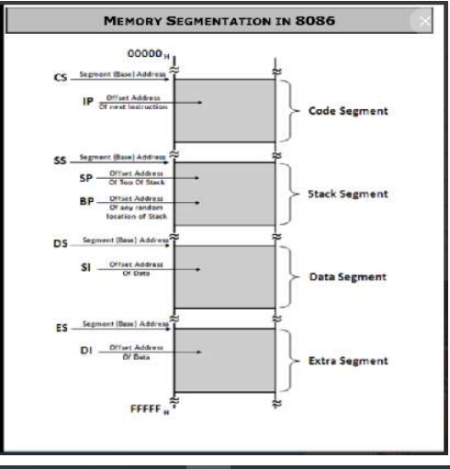
Segment Register(contd..)
We give segment address and offset address both 16 bits addresses as a programmer. After giving this address it is the duty of processor to covert both this address into physical address(real address).
Segment base address
Code segment: offset
CS:IP
physical address = segment address * 10h + offset address
=1000*10+2345
=12345H

Slide 11
Example of physical address
Determine the physical address of a memory location given by 0A51:CD90h.
Physical Address = segment * 10h + offset
=0A51*10h+CD90h
=172A0h

Slide 12
Assignment:
If SS:SP=1234:4267 H find the start , end and the physical address?

